Slide 1
Data Science
CSE-4075
(Probability)

Slide 2
The laws of probability, so true in general, so fallacious in particular.
Edward Gibbon

Slide 3
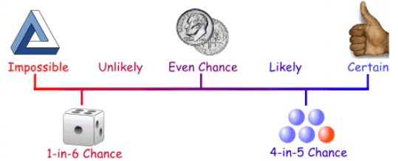
Probability
Probability is the chance that something will happen — how likely it is that some event will happen.

Slide 4
Possible Outcomes...
Tossing a coin

Slide 5
Possible Outcomes...
Tossing a coin
Heads, Tails

Slide 6
Possible Outcomes...
Rolling one of the six-sided dice

Slide 7
Possible Outcomes...
Rolling one of the six-sided dice
Rolling 1, 2, 3, 4, 5, or 6

Slide 8
Certain, Likely, Unlikely or Impossible?
They will be serving some kind of vegetable in the cafeteria at lunchtime.

Slide 9
Certain, Likely, Unlikely or Impossible?
They will be serving some kind of vegetable in the cafeteria at lunchtime.
Likely

Slide 10
Certain, Likely, Unlikely or Impossible?
This month is May, so next month will be June.

Slide 11
Certain, Likely, Unlikely or Impossible?
This month is May, so next month will be June.
Certain

Slide 12
Certain, Likely, Unlikely or Impossible?
Lucas rolls one of his dice. What is the probability he will roll a number less than 2?

Slide 13
Certain, Likely, Unlikely or Impossible?
Lucas rolls one of his dice. What is the probability he will roll a number less than 2?
Unlikely

Slide 14
Certain, Likely, Unlikely or Impossible?
Situation: Ali puts 6 yellow tiles, 2 red tiles, 6 blue tiles, and 21 green tiles in a bag.
What is the probability that Ali will reach in and pull out a red tile?

Slide 15
Certain, Likely, Unlikely or Impossible?
Situation: Ali puts 6 yellow tiles, 2 red tiles, 6 blue tiles, and 21 green tiles in a bag.
What is the probability that Ali will reach in and pull out a red tile?
Unlikely

Slide 16
Certain, Likely, Unlikely or Impossible?
Situation: Ali puts 6 yellow tiles, 2 red tiles, 6 blue tiles, and 21 green tiles in a bag.
What is the probability that Ali will reach in and pull out a green tile?

Slide 17
Certain, Likely, Unlikely or Impossible?
Situation: Ali puts 6 yellow tiles, 2 red tiles, 6 blue tiles, and 21 green tiles in a bag.
What is the probability that Ali will reach in and pull out a green tile?
Likely

Slide 18
Certain, Likely, Unlikely or Impossible?
Situation: Ali puts 6 yellow tiles, 2 red tiles, 6 blue tiles, and 21 green tiles in a bag.
Which two color tiles is Ali equally likely to pull out?

Slide 19
Certain, Likely, Unlikely or Impossible?
Situation: Ali puts 6 yellow tiles, 2 red tiles, 6 blue tiles, and 21 green tiles in a bag.
Which two color tiles is Ali equally likely to pull out?
Yellow and Blue

Slide 20
Certain, Likely, Unlikely or Impossible?
Situation: Ali puts 6 yellow tiles, 2 red tiles, 6 blue tiles, and 21 green tiles in a bag.
How many tiles did Ali put into the bag?

Slide 21
Certain, Likely, Unlikely or Impossible?
Situation: Ali puts 6 yellow tiles, 2 red tiles, 6 blue tiles, and 21 green tiles in a bag.
How many tiles did Ali put into the bag?
35 tiles

Slide 22
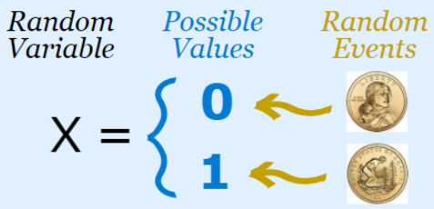
Basic concepts about probability
A random variable (random quantity, aleatory variable, or stochastic variable) is a set of possible values from a random experiment.
Random variables can be discrete or continuous. Discrete random variables can only take certain values while continuous random variables can take any value (within a range).

Slide 23
Basic concepts about probability
The sample space, S, of a probability experiment is the collection of all possible simple events. In other words, the sample space is a list of all possible outcomes of a probability experiment.
Consider the probability experiment of having two flips of fair coin.
Determine the sample space.
S= {(Head, Tail), (Tail, Tail), (Head, Head), (Tail, Head)}
An event is any collection of outcomes from a probability experiment. An event may consist of one or more simple events. Events are denoted using capital letters such as E.
Define the event E = “have one Head”.
E= {(Head, Tail), (Head, Head), (Tail, Head)}

Slide 24

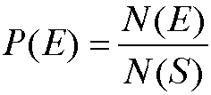
Basic concepts about probability
An experiment is said to have equally likely outcomes when each simple event has the same probability of occurring.
If an experiment has n equally likely simple events and if the number of ways that an event E can occur is m, then the probability of E, P(E), is
So, if S is the sample space of this experiment, then

Slide 25
Basic concepts about probability
Conditional Probability
The notation P(F | E) is read “the probability of event F given event E”. It is the probability of an event F given the occurrence of the event E.
Independent events
Two events E and F are independent if the occurrence of event E in a probability experiment does not affect the probability of event F.
Two events E and F are independent if and only if
P(F | E) = P(F) or P(E | F) = P(E)
Dependent events
Two events are dependent if the occurrence of event E in a probability experiment affects the probability of event F.

Slide 26
Basic concepts about probability
The probability that a randomly selected murder victim was male is 0.7515. The probability that a randomly selected murder victim was less than 18 years old given that he was male was 0.1020. What is the probability that a randomly selected murder victim is male and is less than 18 years old?
P(male and <18)=p(male)*P(<18|male)
=0.7515*0.1020=0.076653
Since P(male) = 0.7515 and
P(< 18 |male ) = 0.1020,
the events “male” and “less than 18 years old” are not independent. In fact, knowing the victim is male decreases the probability that the victim is less than 18 years old .

Slide 27
Basic concepts about probability
IF E and F are both independent events, the probability E and F both occur is:
P(E and F) = P(E). P(F)
The probability that a randomly selected female aged 60 years old will survive the year is 99.186% according to the National Vital Statistics Report, Vol. 47, No. 28. What is the probability that two randomly selected 60 year old females will survive the year?
P(E and F) = 99.186% * 99.186% =98.38%
What is the probability that at least one of 500 randomly selected 60 year old females will die during the course of the year?
1-P(All Survived)=1-0.99186^500=50.4%

Slide 28
Properties of probability
The probability of any event E, P(E), must be between 0 and 1 inclusive. That is,
0 < P(E) < 1.
2. If an event is impossible, the probability of the event is 0.
3. If an event is a certainty, the probability of the event is 1.
4. If S = {e₁, e₂, …, e_{n}}, then
P(e₁) + P(e₂) + … + P(e_{n}) = 1.

Slide 29
Bayes Theorem
can be derived from the basic equation for conditional probabilities

Slide 30
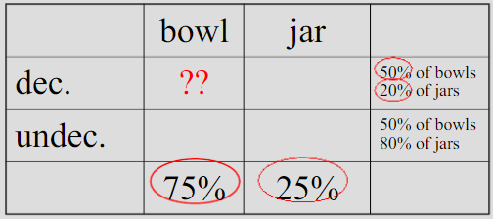
Bayes Theorem
75% of assemblage are bowls, 25% jars
of the bowls, about 50% are decorated
of the jars, only about 20% are decorated
events: B = “bowlness”; A = “decoratedness”
P(B)=??; P(A|B)=??
P(B)=.75; P(A|B)=.50
P(~B)=.25; P(A|~B)=.20
P(B|A)=.75*.50 / ((.75*50)+(.25*.20))
P(B|A)=.88

Slide 31
Probability distribution
Probability distribution is a mathematical function that can be thought of as providing the probabilities of occurrence of different possible outcomes in an experiment.
A discrete probability distribution can be encoded by a discrete list of the probabilities of the outcomes, known as a probability mass function. (Applicable to the scenarios where the set of possible outcomes is discrete, such as a coin toss or a roll of dice) .
A continuous probability distribution is typically described by probability density functions with the probability of any individual outcome actually being 0. (Applicable to the scenarios where the set of possible outcomes can take on values in a continuous range (e.g. real numbers), such as the rain on a given day).
Notes:
A probability mass function is a function that gives the probability that a discrete random variable is exactly equal to some value. All the values of this function must be non-negative and sum up to 1.
Probability distribution function is used to specify the probability of the random variable falling within a particular range of values, as opposed to taking on any one value.

Slide 32
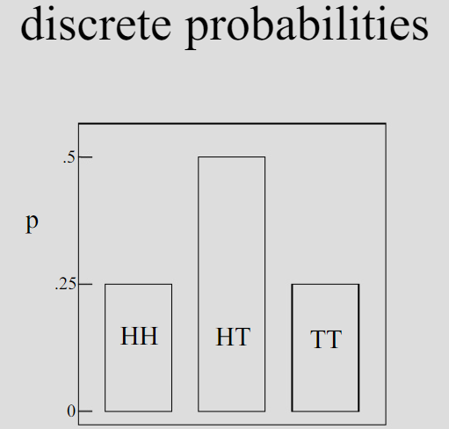
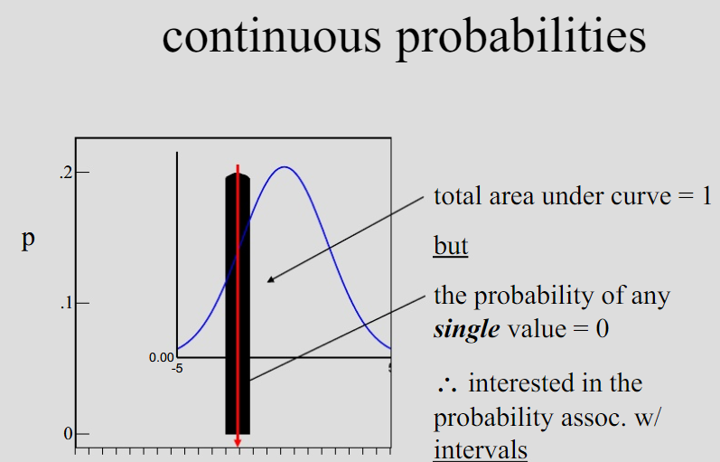
Discrete vs Continuous probability distribution

Slide 33
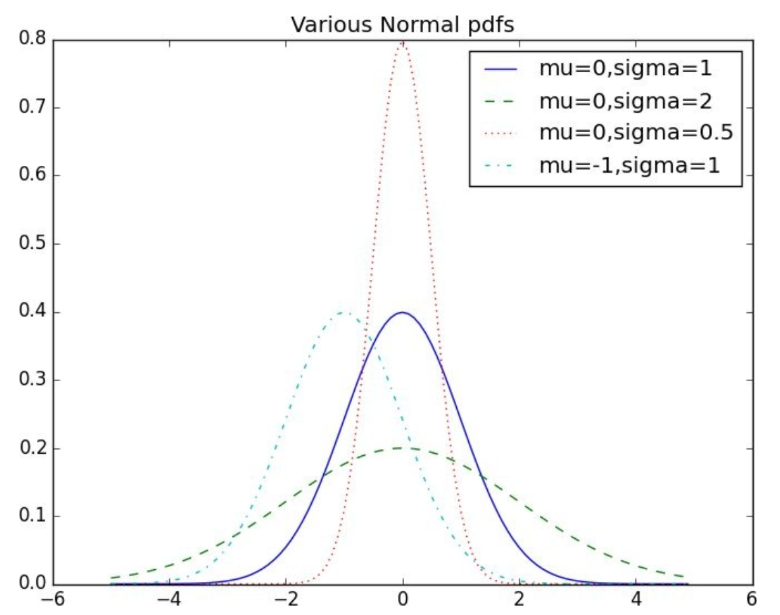
Normal distribution
The king of distributions, also called Gaussain distribution.
Classic bell curve–shaped distribution
Completely determined by two parameters: its mean (mu) and its
standard deviation (sigma).
The mean indicates where the bell is centered, and the
standard deviation how “wide” it is.

Slide 34
Properties of Normal Distribution Curve
The normal (distribution) curve
From μ–σ to μ+σ: contains about 68% of the measurements (μ: mean, σ: standard deviation)
From μ–2σ to μ+2σ: contains about 95% of it
From μ–3σ to μ+3σ: contains about 99.7% of it

Slide 35
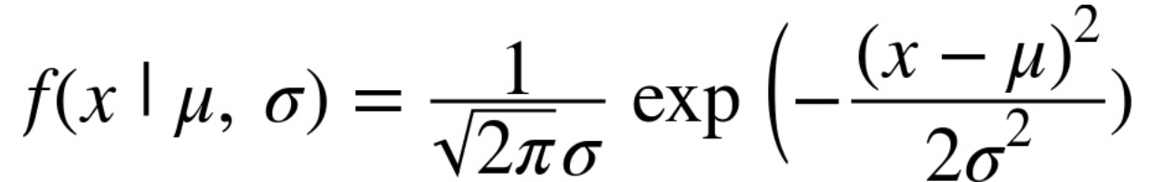
Normal distribution
Probability distribution function:
summarizes how odds/ probabilities are distributed among the events that can arise from a series of trials

Slide 36
Central Limit Theorem
The central limit theorem (CLT) establishes that, in most situations, when independent random variable are added, their properly normalized sum tends toward a normal distribution (informally a "bell curve") even if the original variables themselves are not normally distributed.
If one flips a coin many times, the probability of getting a given number of heads in a series of flips will approach a normal curve, with mean equal to half the total number of flips in each series.

Slide 37
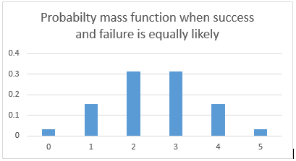
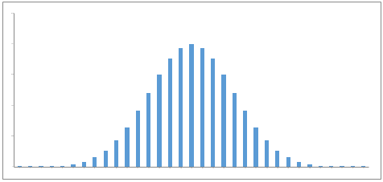
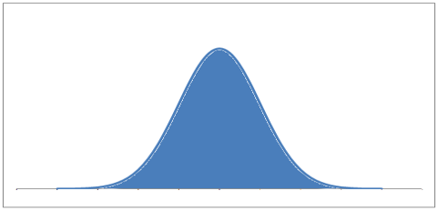
Central Limit Theorem

Slide 38
Implementation

Slide 39
Conditional probability
A family is having two (unknown) children.
If we assume that:
1. Each child is equally likely to be a boy or a girl
2. The gender of the second child is independent of the gender of the first child
then the event “no girls” has probability 1/4, the event “one girl, one boy” has probability 1/2, and the event “two girls” has probability 1/4.
What is the probability of the event “both children are girls” (B), conditional on the event “the older child is a girl” (G)?
What is the probability of the event “both children are girls” (B), conditional on the event “at least one of the children is a girl” (L).

Slide 40
Conditional probability
import randomdef random_kid():
return random.choice(["boy", "girl"])
both_irls = 0
older_girl = 0
either_girl = 0
random.seed(0)
for _ in range(10000):
younger = random_kid()
older = random_kid()
if older == "girl":
older_girl += 1
if older == "girl" and younger == "girl":
both_girls += 1
if older == "girl" or younger == "girl":
either_girl += 1
print ("P(both | older):", both_girls / older_girl)
print ("P(both | either): ", both_girls / either_girl)
P(both | older): 0.5007089325501317
P(both | either): 0.3311897106109325

Slide 41
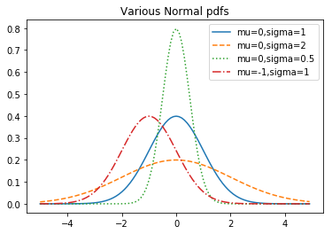
Conditional probability
import matplotlib.pyplot as plt
import math
def normal_pdf(x, mu=0, sigma=1):
sqrt_two_pi = math.sqrt(2 * math.pi)
return (math.exp(-(x-mu) ** 2 / 2 / sigma ** 2) / (sqrt_two_pi * sigma))
xs = [x / 10.0 for x in range(-50, 50)]
plt.plot(xs,[normal_pdf(x,sigma=1) for x in xs],'-',label='mu=0,sigma=1')
plt.plot(xs,[normal_pdf(x,sigma=2) for x in xs],'--',label='mu=0,sigma=2')
plt.plot(xs,[normal_pdf(x,sigma=0.5) for x in xs],':',label='mu=0,sigma=0.5')
plt.plot(xs,[normal_pdf(x,mu=-1) for x in xs],'-.',label='mu=-1,sigma=1')
plt.legend()
plt.title("Various Normal pdfs")
plt.show()

